Slide 1

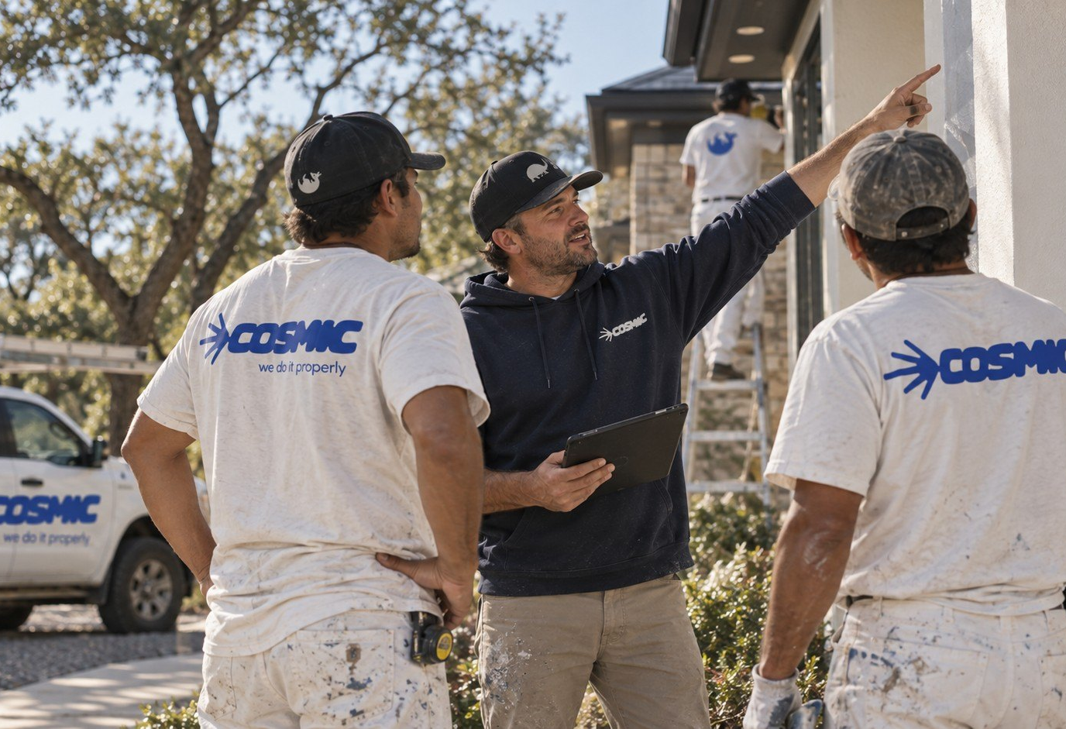
01 / 06
NEW LOOK.
SAME CREW.
A fresh identity, from the people you already know.
Notes:
rebrand/02-a-cover

Slide 2

02 / 06
WHAT
CHANGED.
01
THE LOOK
Logo, colours and lettering.
02
THE UNIFORM
Jackets, caps and coveralls.
03
ARLO
The newest member of the crew.
04
THE WEBSITE
choosecosmic.com
Notes:
rebrand/03-a-changed

Slide 3


NEW LOOK, SAME CREW
03 / 06
WHAT
DIDN'T.
THE CREW
The people on site.
THE STANDARD
Do it properly.
NO SURPRISES
Clear from the first estimate.
Notes:
rebrand/04-a-same

Slide 4

THE NEWEST MEMBER
04 / 06
MEET
ARLO.
Tough shell. Soft spot for good work.
Notes:
rebrand/05-a-arlo

Slide 5

05 / 06
OUR PROMISE
WE CARE,
IT SHOWS.
CLARITY
CRAFT
No surprises.
Do it properly.
CARE
COMMIT
Leave it better.
See it through.
Notes:
rebrand/06-a-promise

Slide 6

06 / 06
HAVE A PROJECT IN MIND?
Get a clear estimate
choosecosmic.com
(512) 348-6433 · (512) 348-6232
2301 W Anderson Ln
Austin, TX 78757
[TBC: SUITE]
[TBC: HANDLE]
Notes:
rebrand/07-a-cta

Slide 7

THE NEW LOOK
01 / 05
SAME PLACES.
DIFFERENT
STANDARD.
The new Cosmic, piece by piece.
Notes:
rebrand/08-b-cover

Slide 8
02 / 05
THREE
COLOURS.
Blue leads. Cream and ink do the rest.
BLUE
CREAM
INK
#362CFF
#ECE9E0
#171726
Notes:
rebrand/09-b-colours

Slide 9




03 / 05
A LITTLE
PERSONALITY.
Script lettering and stickers for the details.
Notes:
rebrand/10-b-lettering

Slide 10
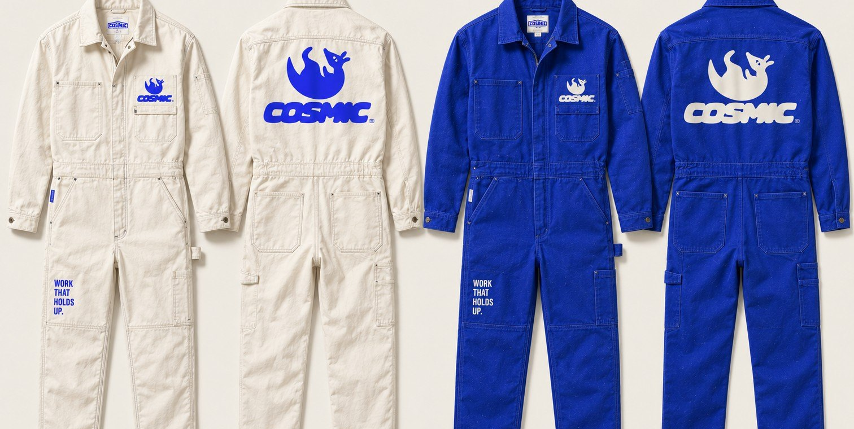
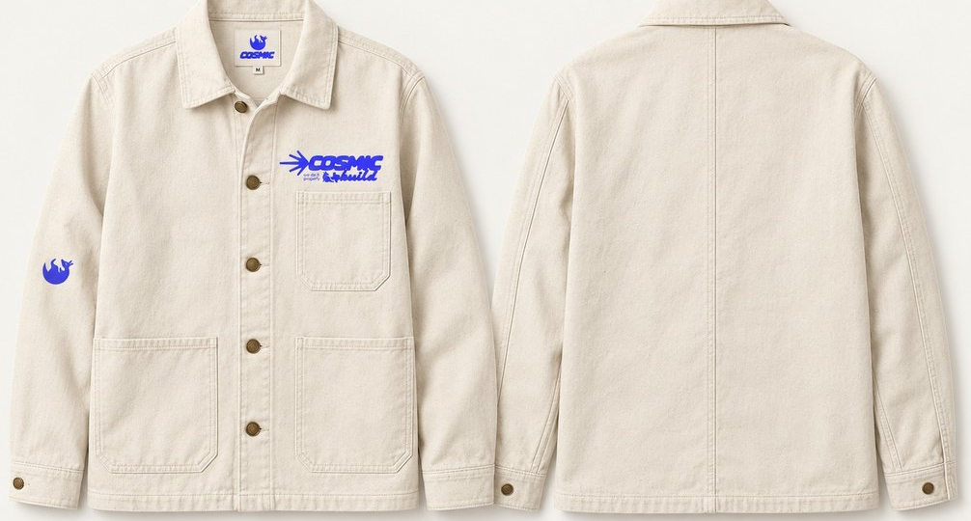
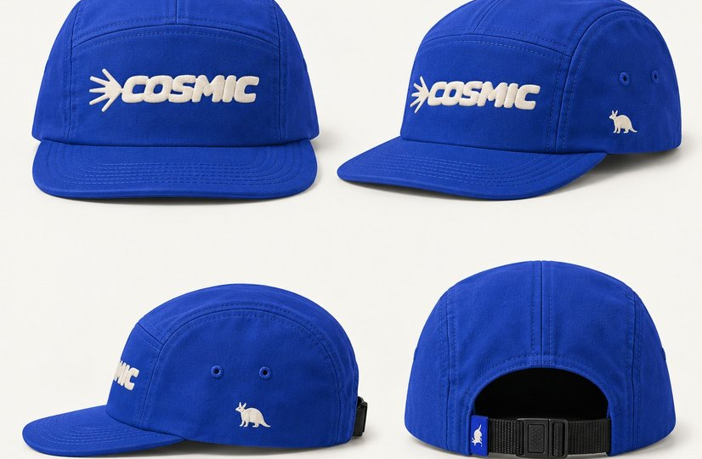
THE UNIFORM
04 / 05
SAME CREW.
NEW UNIFORM.
Jackets, caps and coveralls in Cosmic blue and cream.
Notes:
rebrand/11-b-uniform

Slide 11
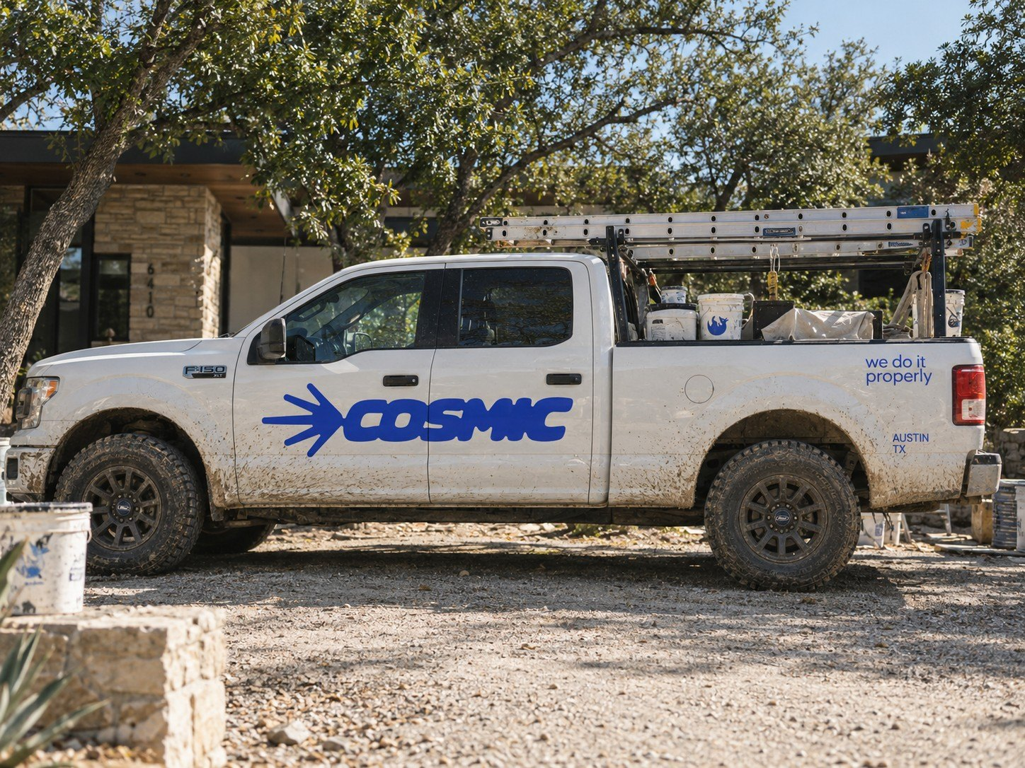
05 / 05
LOOK FOR
THE TRUCK.
choosecosmic.com
Get a clear estimate
Notes:
rebrand/12-b-truck

